Slide 1

ELENDIL – HOME OF AI SERVICES
Presented by:
Ashwini R. Jawale (226237)
MSc-CS (SEM-IV)

Slide 2

Company profile
ELENDIL is a service-based startup.
The company provides various AI services that range from AI Model Development designed for superior performance in image, text, to transforming Android devices into intelligent companions by bringing unparalleled intelligence of Android AI applications.
The company specializes in creating high-end AI driven chatbots on your own data, and websites and mobile apps too.
Also, Data Analytics, from creating useful interactive dashboards to analyzing large documents.

Slide 3
Hardware REQUIREMENT
Mobile Device:
Android or iOS smartphone or tablet capable of running React applications.
Recommended specifications:
Android: Devices running Android 5.0 or higher and minimum 2GB RAM, 1.5GHz processor.
iOS: Devices running iOS 10 or higher, including iPhones and iPads.

Slide 4
SOFTWARE REQUIREMENT
Visual Studio Code – For Development and Coding
Operating System – Windows 11
Browser – Microsoft Edge, Google Chrome
Frontend – React JS, CSS, Bootstrap, Firebase Realtime Database/Authentication
Backend – Python, Gemini LLM Model

Slide 5
OVERVIEW - PROJECT-I
The project titled ‘AI SERVICES AT GLANCE’ dwells into making AI Services available for customers at a cheaper and effective cost. Providing various LLM features as a service to clients. It provides easy interface for the clients to come and acquire various LLM features.

Slide 6
Technology used
React JS
Firebase
GeminiLLM Model (Backend AI APIs)

Slide 7
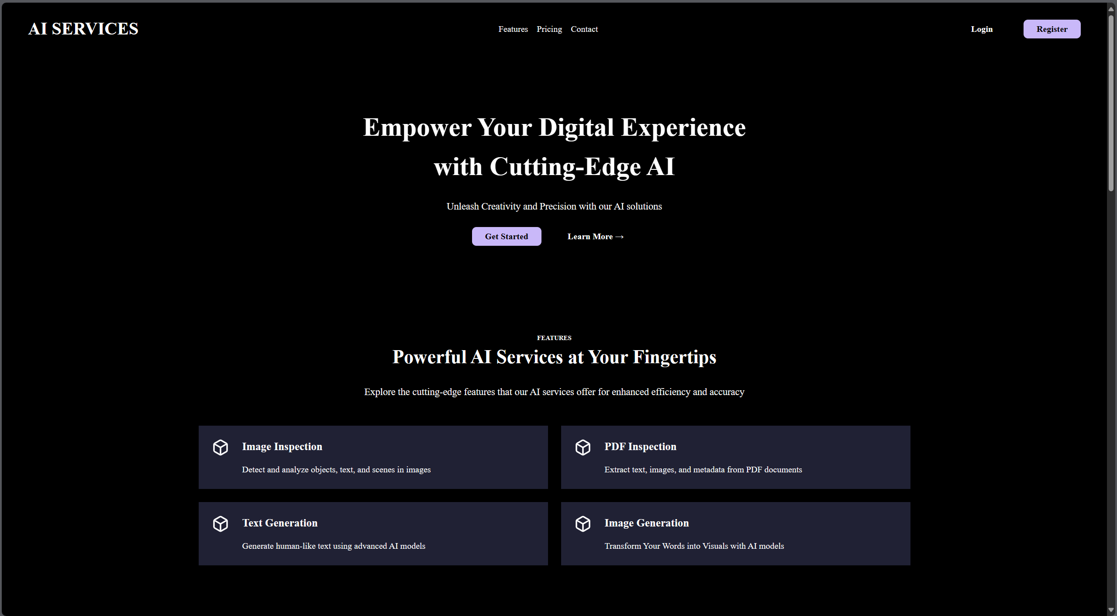
PROJECT-I SCREENSHOTS

Slide 8
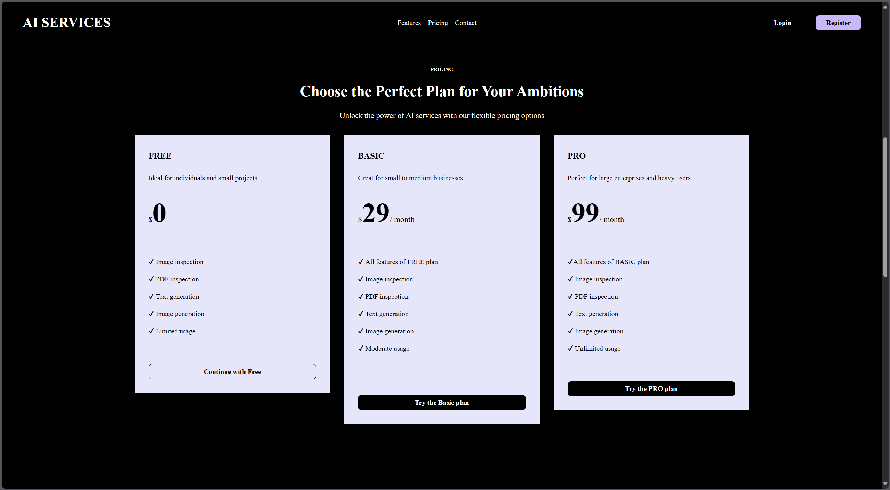

Slide 9
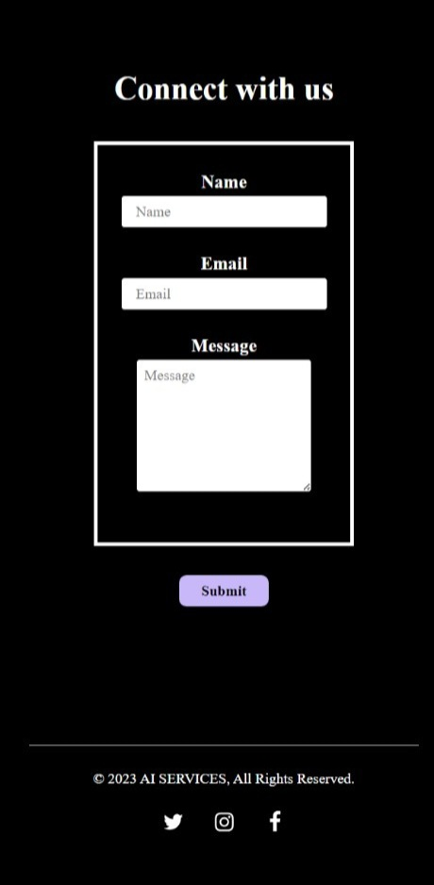

Slide 10
My contribution
Worked on Frontend technologies and UI with the Frontend team using React JS, firebase. Designed Company’s Introduction page/Landing page. The main components were –
Login
Services
Pricing
Products
About
Client/User - Form
And then deployed it on firebase.

Slide 11
PROJECT-II
The project titled ‘AAFIYA – MEDICAL DIAGNOSTICS’ utilizes state of Art Deep Learning and AI Models to diagnose cancer and other deadly diseases. So, to help identify cancers and other disorders at early stages so as to effectively treat them.

Slide 12
Technology used
React JS
Firebase
Routing Libraries (React Router)

Slide 13
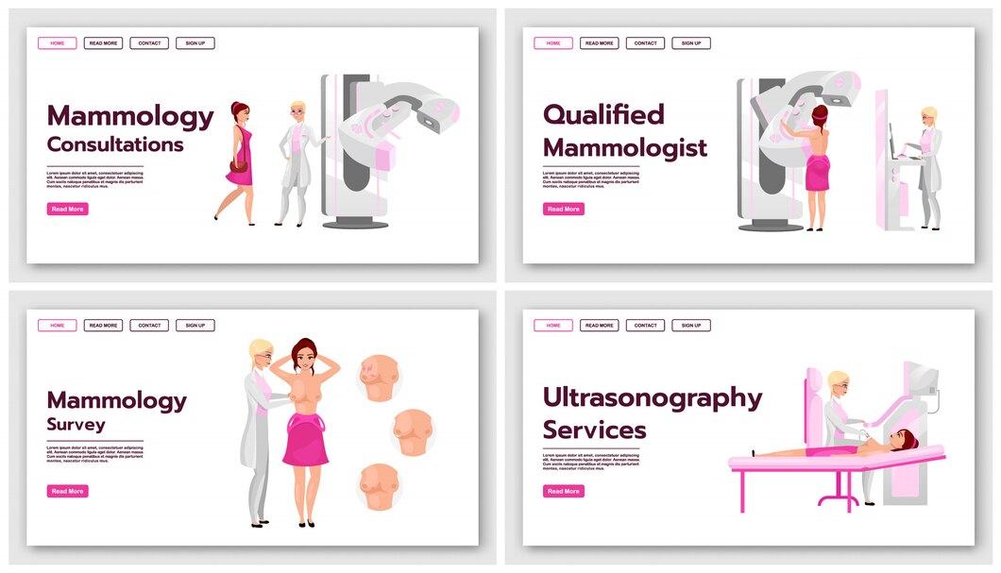
PROJECT-II SCREENSHOTS

Slide 14
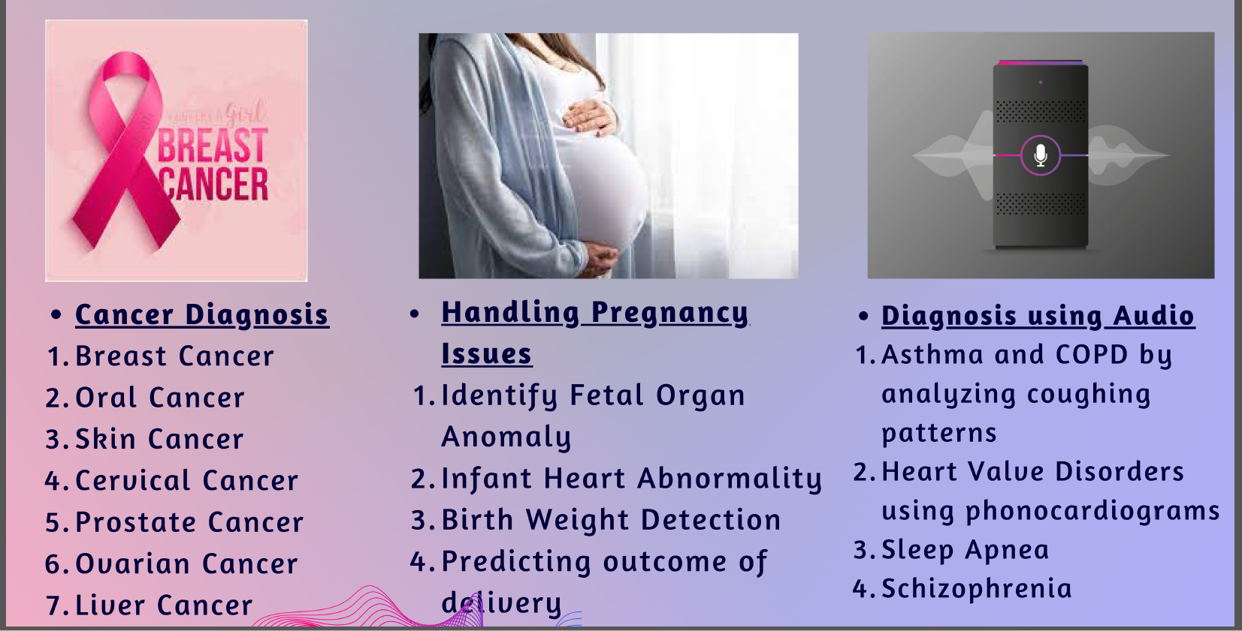

Slide 15
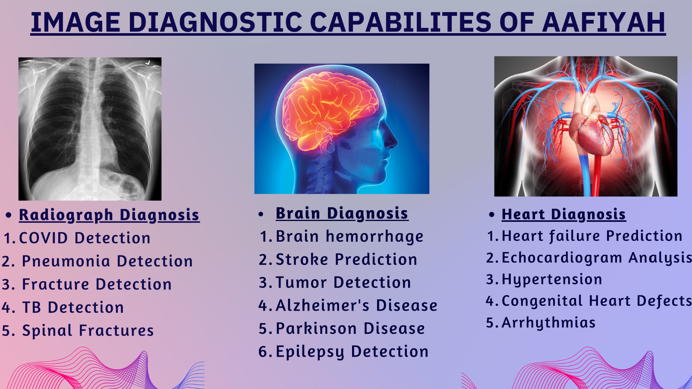

Slide 16
My contribution
Worked on Frontend technologies and UI using React JS, firebase. Designed the Project’s Introduction page/Landing page where there are various categories of diagnosis such as –
Cancer Diagnosis
Handling Pregnancy Issues
Diagnosis using Audio
Radiograph Diagnosis
Brain Diagnosis
Heart Diagnosis

Slide 17
PROJECT-III
The project titled ‘Chatbot Service’, that intends to help clients with question and answering over their own dataset, thus increasing the efficiency of the product. The users can also upload various documents such as images, pdf files, etc.

Slide 18
Technology used
React JS
Firebase Realtime Database/Authentication
Dialogflow (Natural Language Platform)

Slide 19
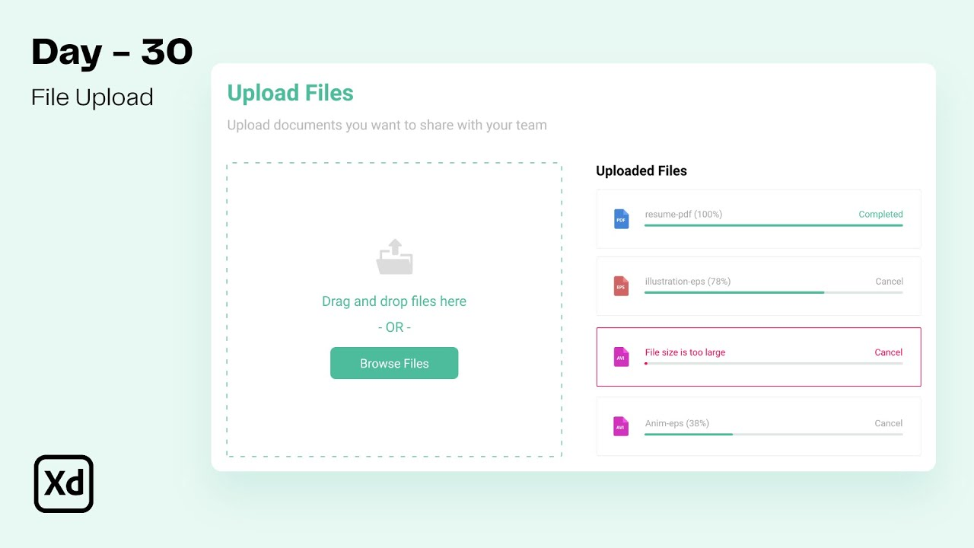
PROJECT-Iii SCREENSHOTS

Slide 20
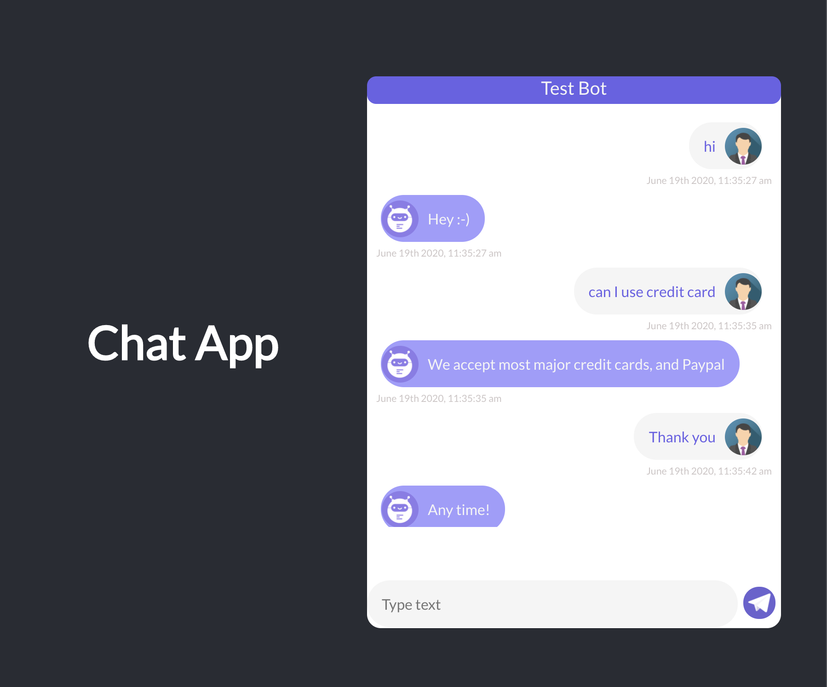

Slide 21
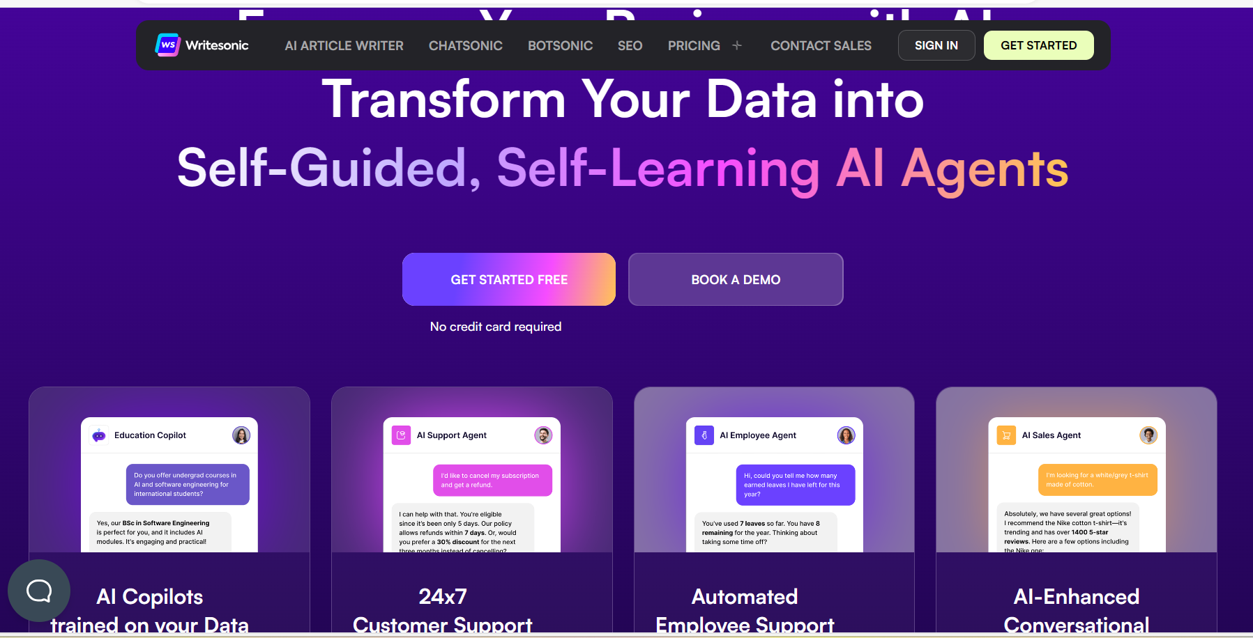

Slide 22
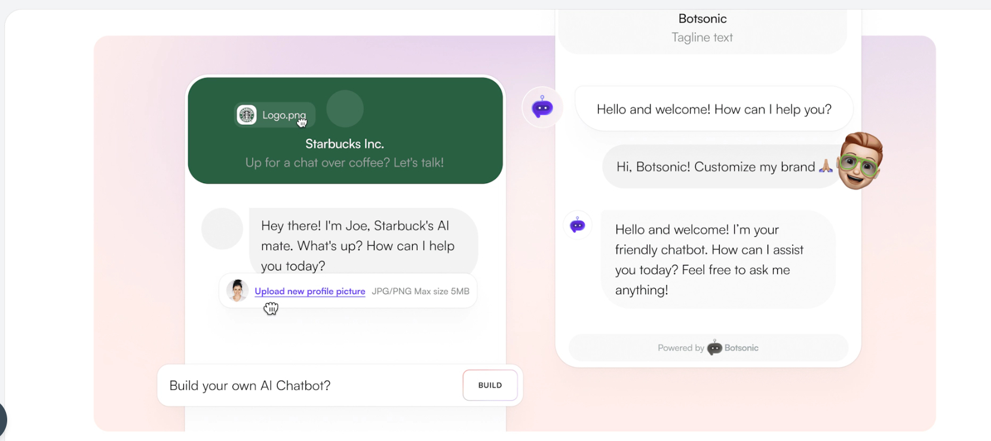

Slide 23
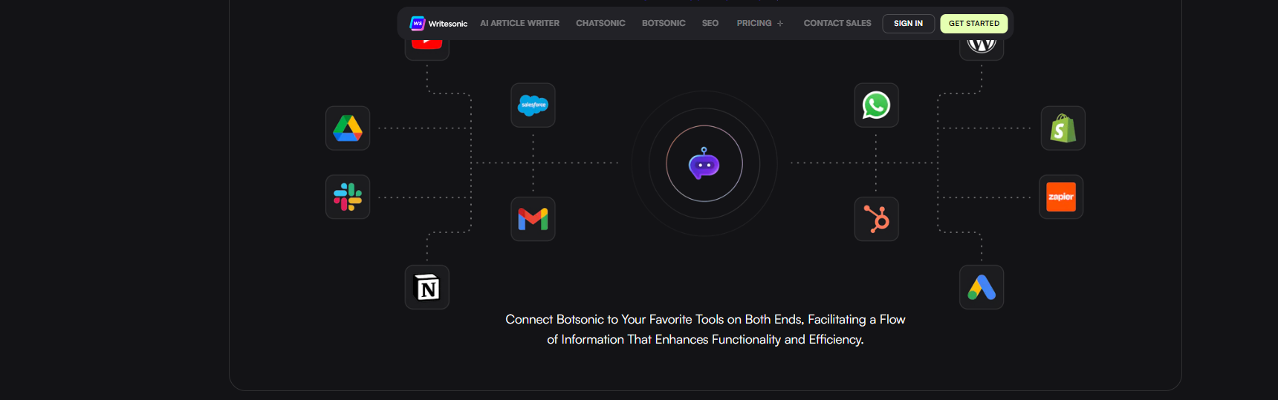

Slide 24
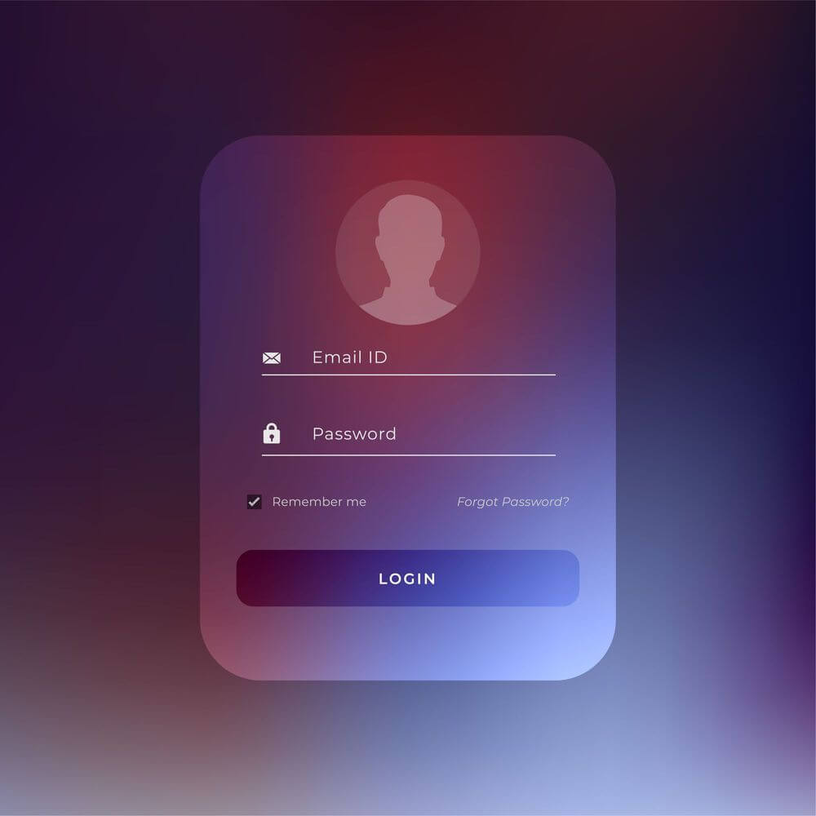

Slide 25
My contribution
Worked on Frontend technologies and UI using React JS to design a creative Introduction/Landing page for Chatbot Service.
Designed a document upload to upload pdf, docx, images which is stored as a history.
Designed a Chatbot-chat window where a user is able to send message and get a bot-response.
Used ‘Dialogflow’, a Natural Language Platform to train the user and bot-response (text responses).
Firebase Authentication - Designed a Login-Form where once a user is authenticated, Firebase Authentication automatically manages user sessions and provides a unique user ID for each authenticated user.

Slide 26
New technologies learnt- dialogflow
Google Cloud’s ‘Dialogflow’ is a natural language understanding platform developed by Google that enables developers to design and build conversational interfaces, such as chatbots and virtual agents.
It allows developers to create conversational interfaces that can understand natural language input from users and provide appropriate responses.

Slide 27
Agents:
An agent in Dialogflow represents a virtual agent or conversational interface that can understand and respond to user queries.
Agents are designed to interpret user input (text or voice) and provide appropriate responses based on predefined knowledge and logic.
Each agent consists of various components, including intents, entities, contexts, and fulfillment, which collectively enable it to understand and respond to user queries effectively.

Slide 28
Intents:
Intents define the purpose or goal of a user's input in a conversation. They represent what the user wants to achieve or inquire about.
Intents also specify the actions or responses that the agent should take when a user's input matches the intent.
By defining and configuring intents within agents, developers can create robust conversational experiences that effectively understand and respond to user queries.

Slide 29
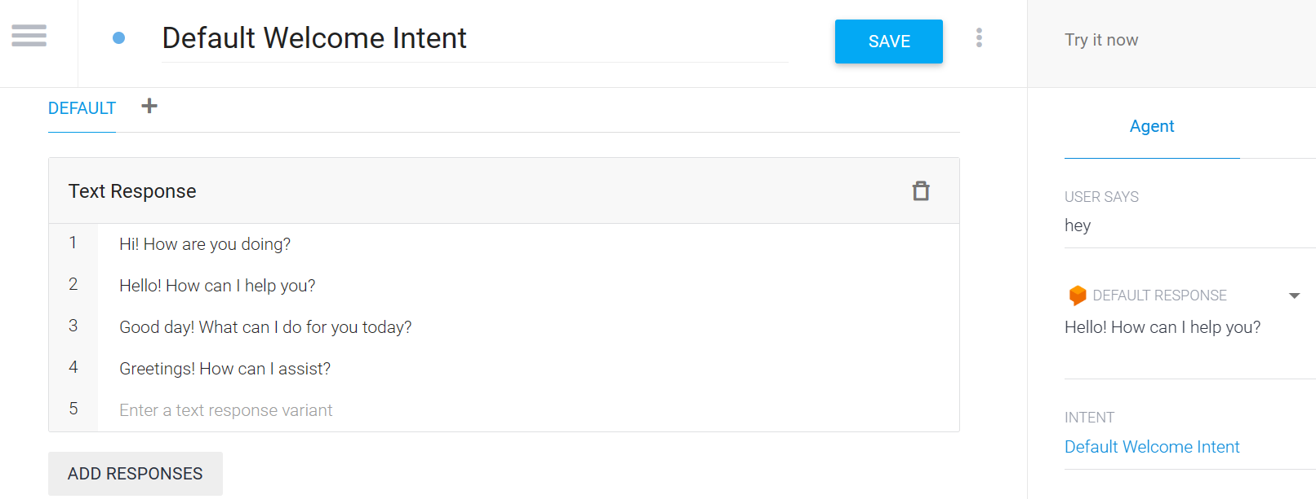
EXAMPLES:
The Default Welcome Intent is triggered when a user starts a conversation with your agent. It's typically the first interaction users have with your agent. This intent is used to greet users.

Slide 30
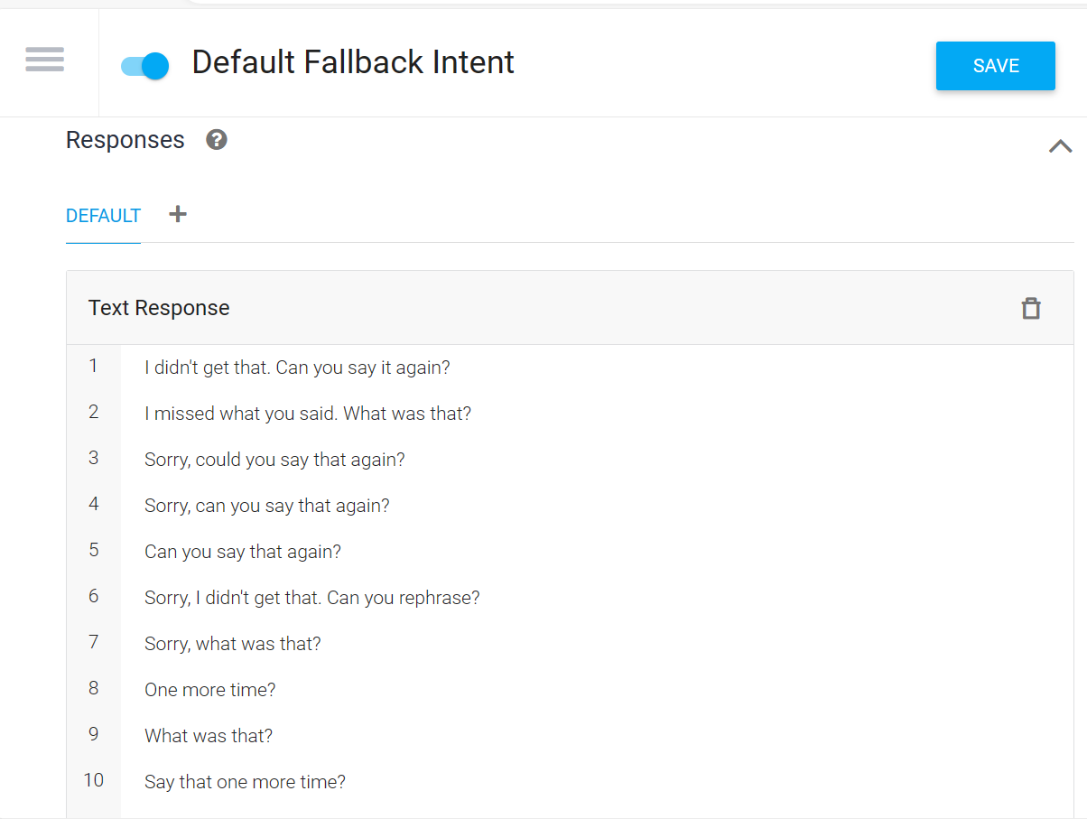
The Default Fallback Intent is triggered when Dialogflow is unable to match user input to any of the defined intents in your agent. This intent acts as a safety net to handle unexpected or unrecognized user queries.

Slide 31
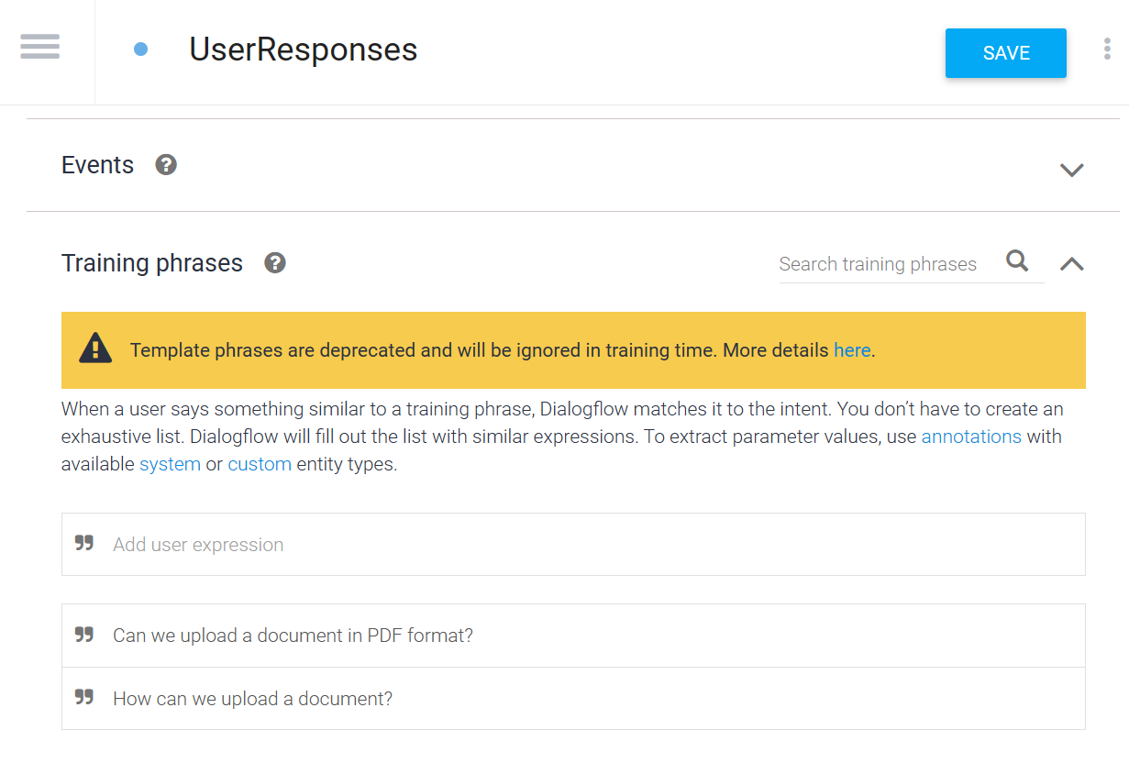
USER RESPONSES:

Slide 32
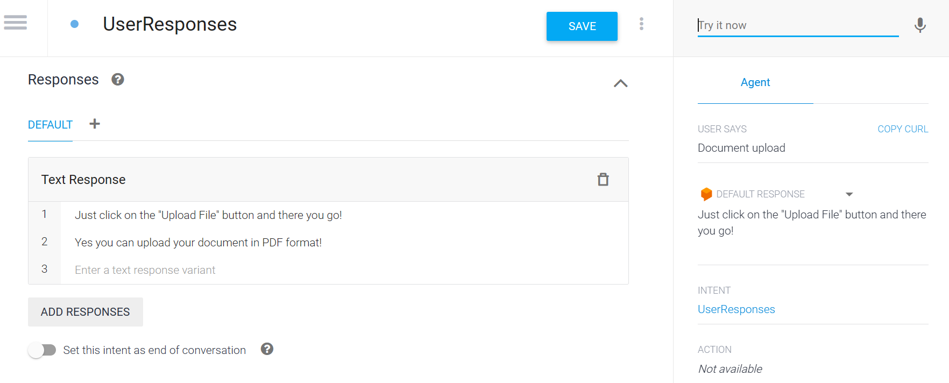
USER RESPONSES:

Slide 33
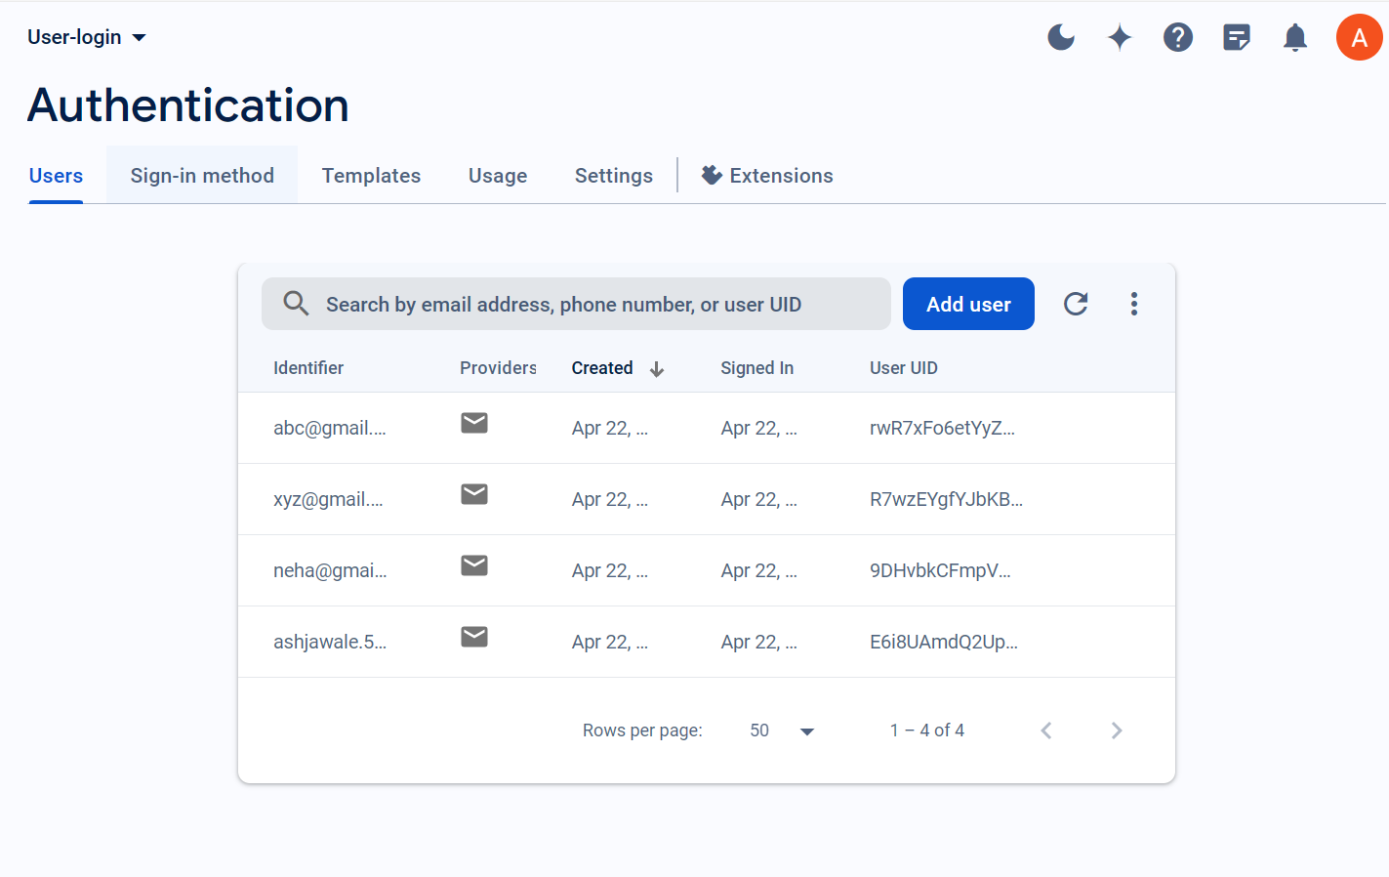
FIREBASE-Authentication
‘Firebase Authentication’ allows users to sign up and sign in to your application using various authentication providers. Users can create accounts with email/password credentials or sign in with their existing accounts.

Slide 34
Soft skills developed during internship
Self – Learning Ability
Team Work
Problem Solving Skills
Time Management
Communication Skills

Slide 35
Thank you!

